Slide 1
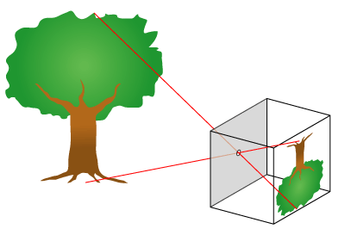
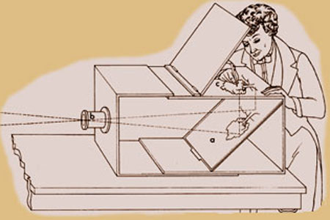
Camera Obscura (“dark room”)
In 1558, Giovanni Battista
developed an artists’ aid for
painting and drawing.
He used the basic law of
physics that light travels in a straight line.
This was discovered by observing light passing through a pinhole to produce an inverted image on the opposite wall of a darkened room.
A convex lens was added to help focus the image, and a mirror to reflect the image onto a drawing surface to be traced.

Slide 2
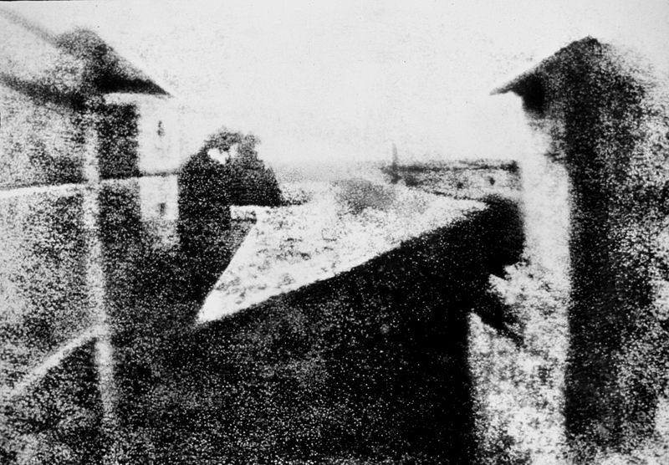
Photography (“light-writing”)
Fixing a permanent image was the most magical discovery made by Joseph Nicephore Niepce in 1826.
The exposure took over eight hours.
By 1833, Louis Jacques Madre Daguerre and William Henry Fox Talbot reduced the exposure time to only several minutes.
The first negative/process was then discovered so images could be reproduced.

Slide 3
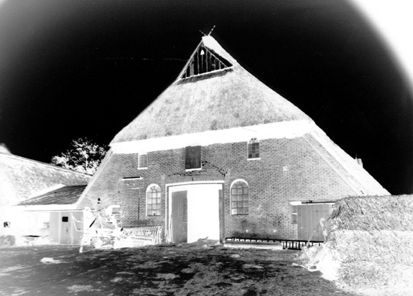
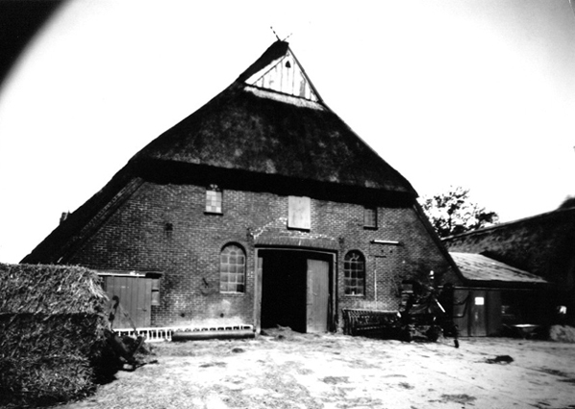
“The negative is the equivalent of the composer’s score, and the print the performance.”
Ansel Adams

Slide 4
The Pinhole Perspective
“A good photograph
is knowing where to stand.”
Ansel Adams

Slide 5
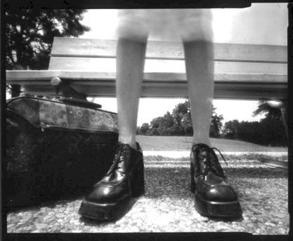

Slide 6
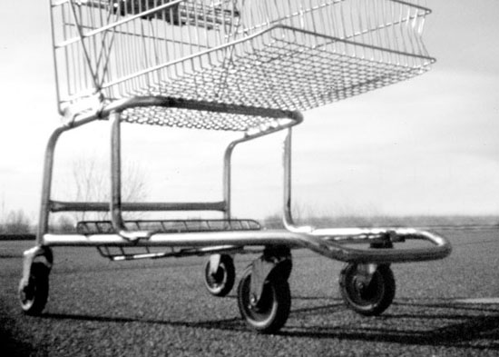

Slide 8
Lining Things Up
“I really believe there are
things nobodywould see if
I didn’t photography them.”
Diane Arbus

Slide 9
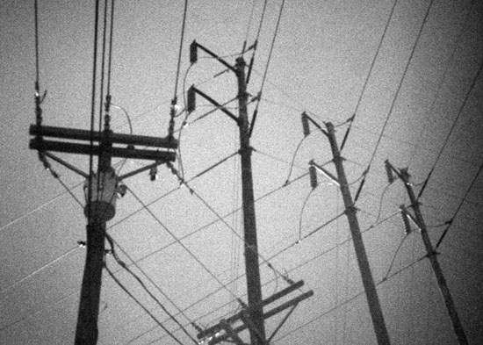

Slide 10
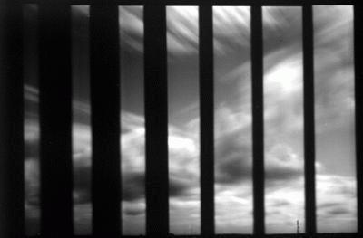

Slide 11
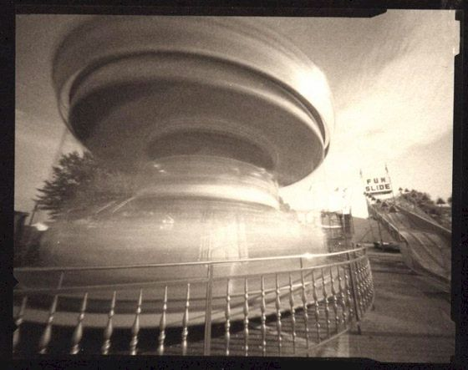
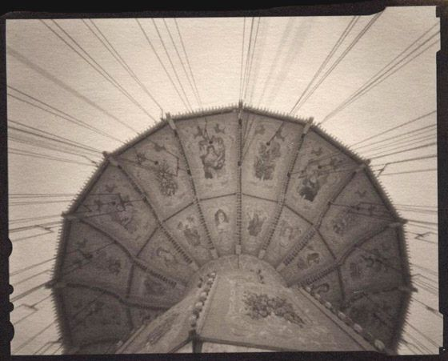

Slide 12
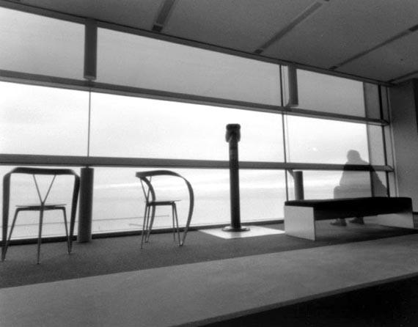

Slide 13
Make use of
LIGHT

Slide 14
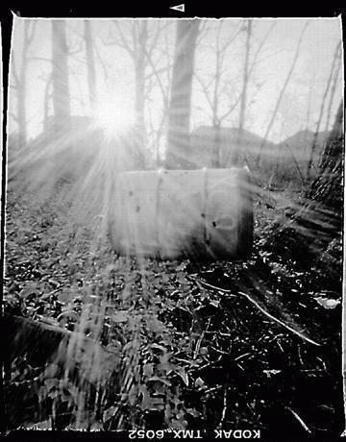

Slide 15
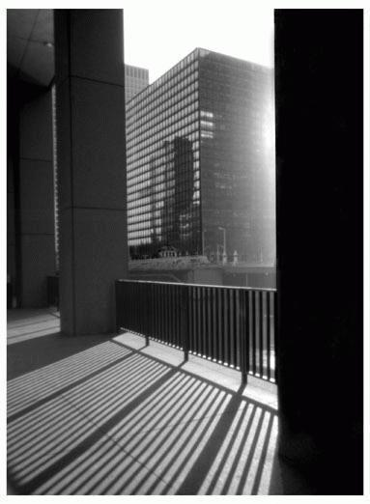

Slide 16
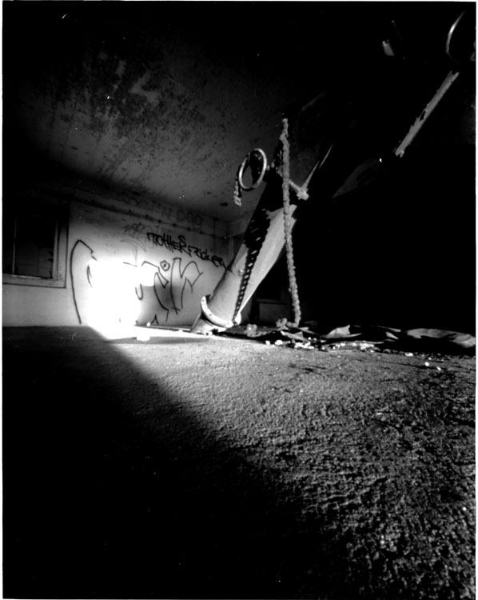

Slide 17
The Power of Angles
If you pictures aren’t good enough
you’re not close enough.”
Robert Capa

Slide 18
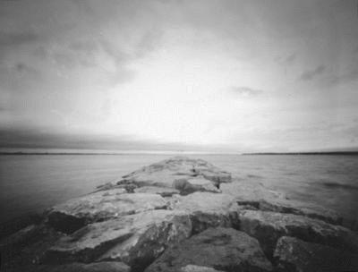

Slide 19
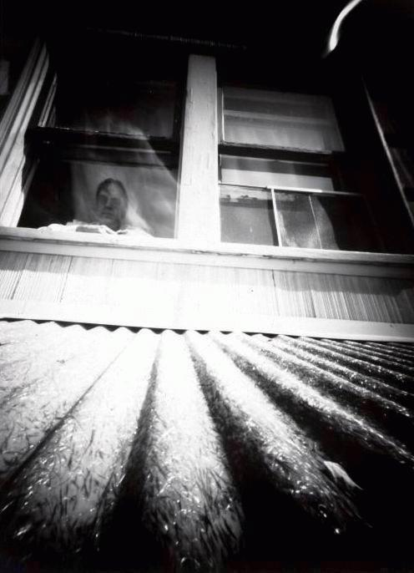

Slide 20
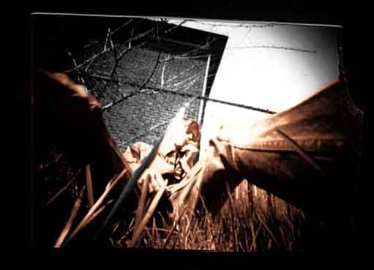

Slide 21
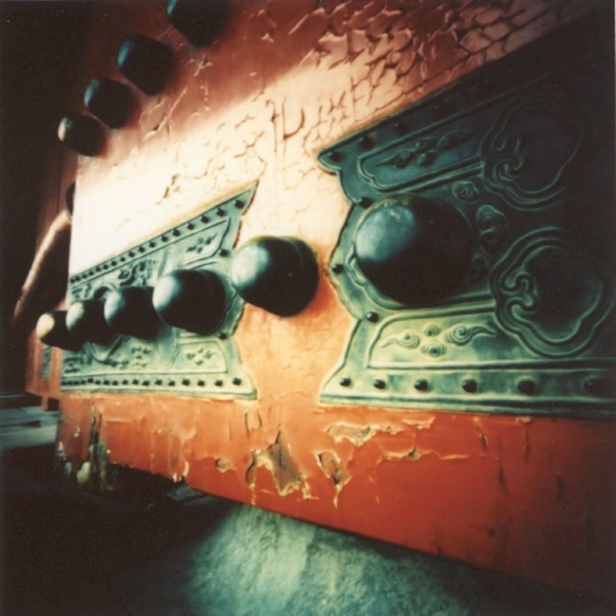

Slide 22
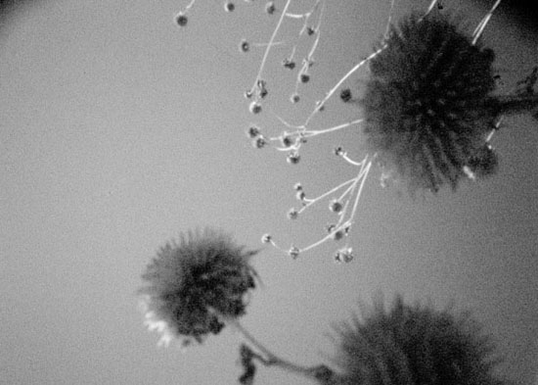

Slide 23
Other Pinholes Cameras

Slide 24
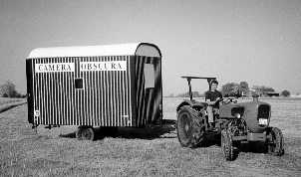

Slide 25
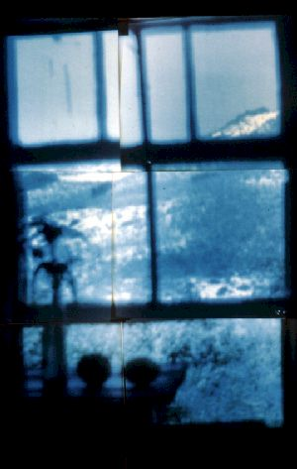

Slide 26
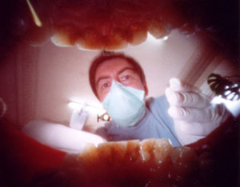
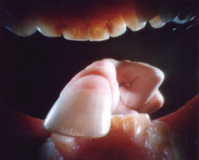

Slide 27
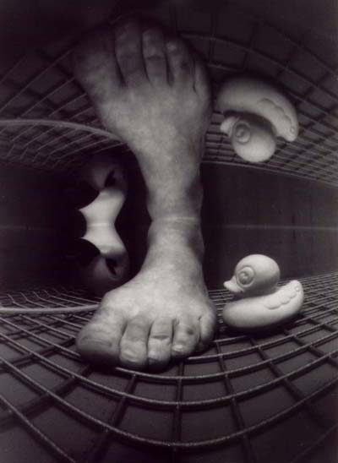

Slide 28
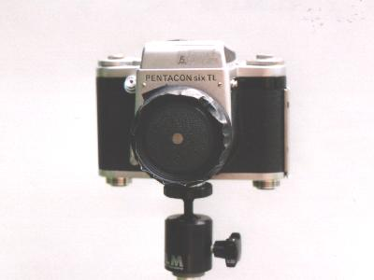

Slide 29
